Slide 1
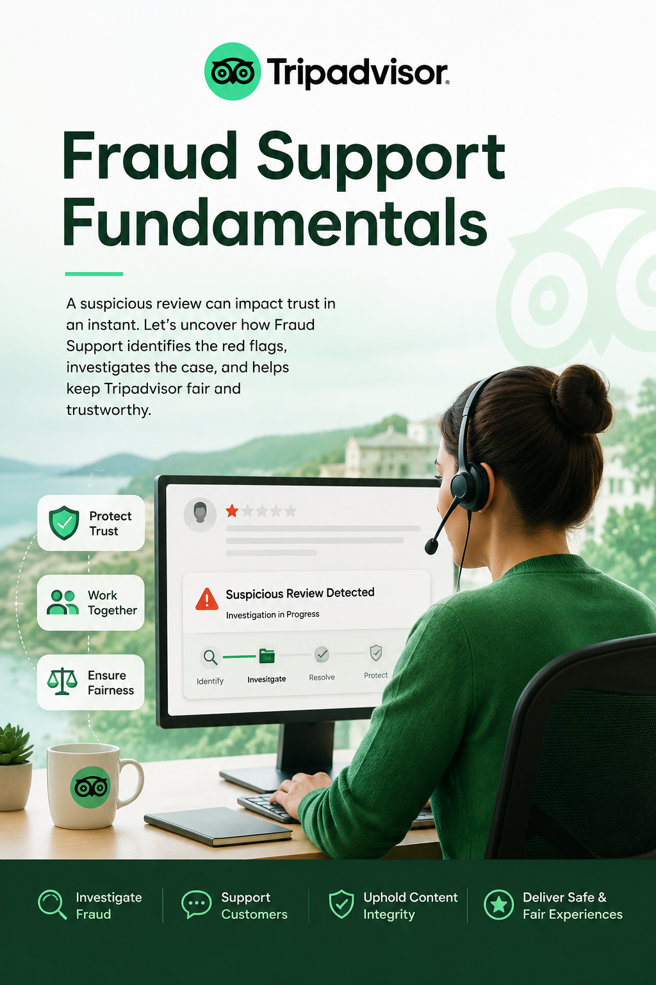

“Module: 1
Fraud Support Fundamentals”
“Behind every suspicious review lies an investigation that protects millions of travelers.”
@ Module 1
Welcome to Fraud Support Fundamentals

Slide 2


House Rules!
Follow the best practices below to ensure a smooth learning experience.
Be on time. Every minute counts!
Check your internet, microphone, and camera once you login
Be present, not just logged in!
Use the Raise Hand / Chat feature to participate
Ask questions, don't wait for the “perfect” question
If you're wondering about it, chances are someone else is too.
Happy Learning!

Slide 3
Agenda
Meet your Tier 2 Team
Quick introductions on who you will be working with!
Introduce yourself
Let’s play a fun game to know more about your peers.
CMI vs. FS
A side-by-side comparison to understand transition from CMI to FS.
The mission of Fraud Support
Understand how Fraud Support helps keep content genuine, fair, and trustworthy.
Who reaches out to us and why
Learn more about the types of contacts that reach out to FS.
Understanding our two main conversation types: FS and FPS
FS & FPS deep dive.

Slide 4
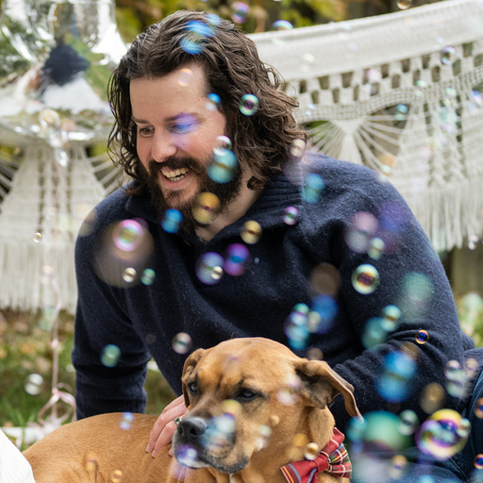
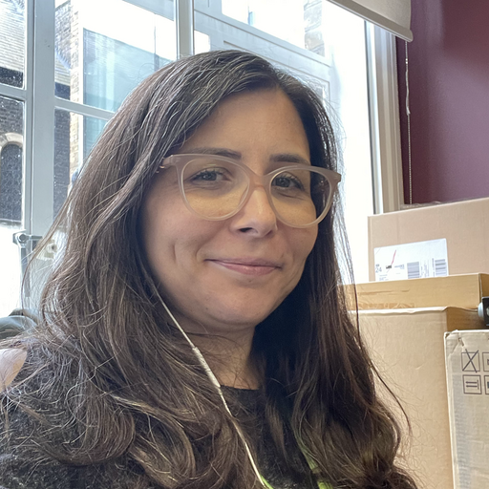
Get to Know Your Tier 2 Team
Get to know the small but mighty Tier 2 team of senior specialists who handle complex escalations.
Jacob (Jake) Nicoletti
Marina Lomboni
MANAGER
SR. SPECIALIST
Joined Nov 2025. A former federal agent and cyber-ops manager now protecting your vacations.
Part of the team since 2011, born in Italy and based in London.
Tripadvisor / Fraud Support / Tier 2 Team

Slide 5

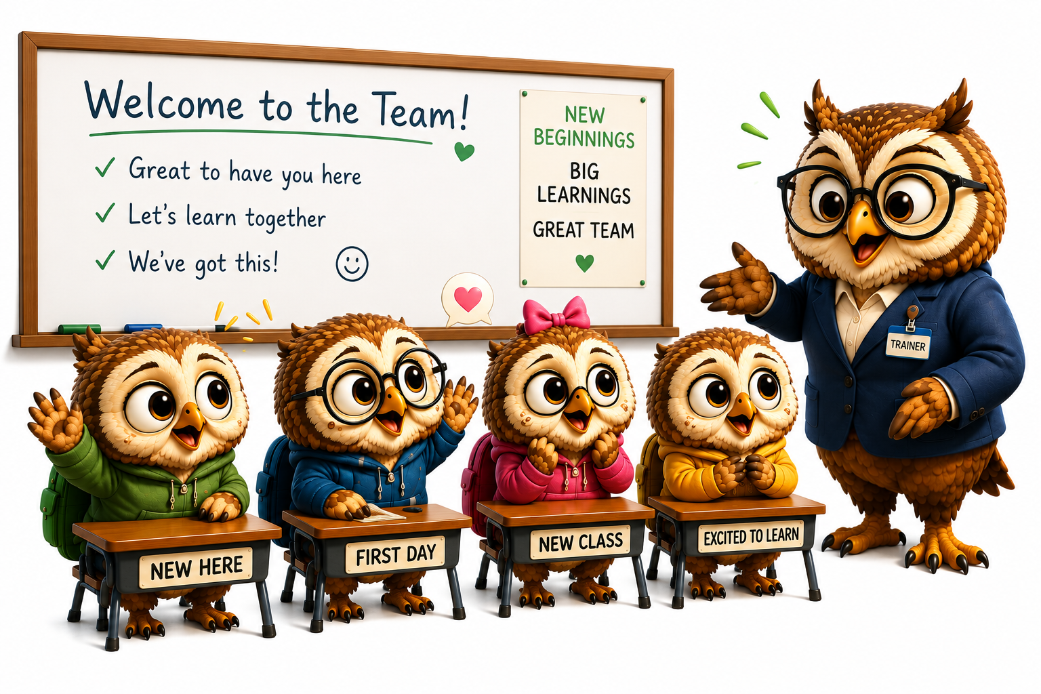



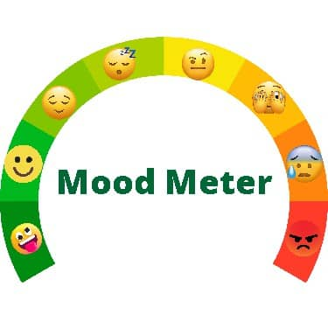

Introduction - Get to know each other
Start with your ‘Name’
One Weird / Funny Talent
What you’re excited to learn
Current mood in one word
Tripadvisor / Fraud Support / Team Introduction

Slide 6
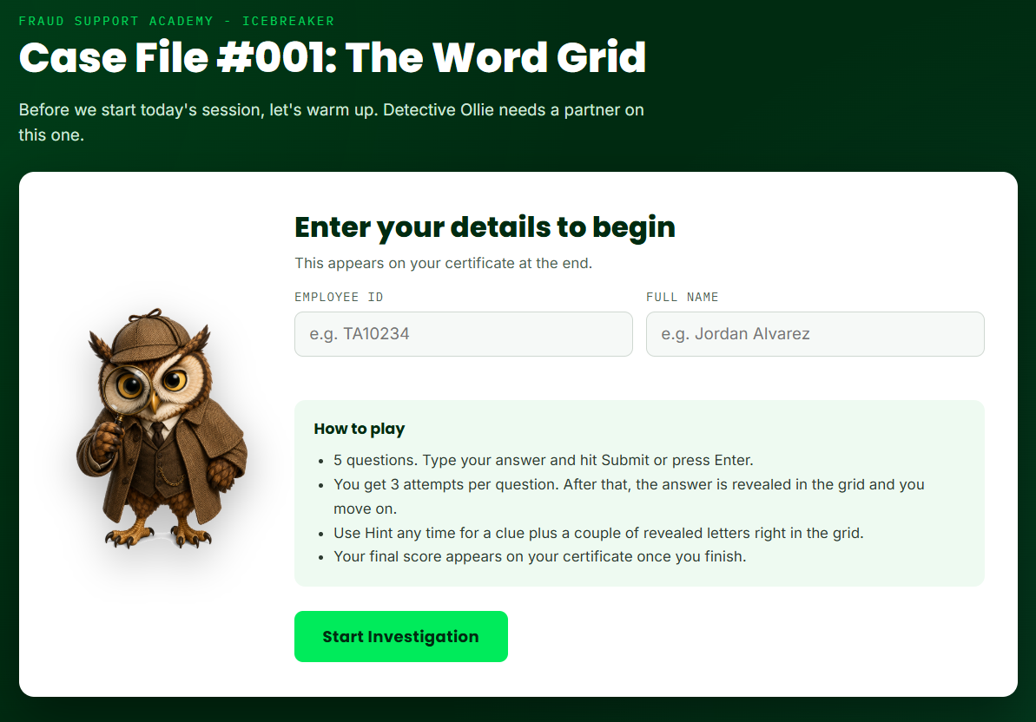
Icebreaker
Before we dive into today’s session, let’s warm up with a quick challenge! Detective Ollie has a mystery to solve and he needs your help.
Unlock
Ready to switch on your detective mode?

Slide 7
CMI vs. FS
CMI: “Does this content violate policy?”
FS: “Is there evidence someone is trying to manipulate the platform?”
Reviews individual pieces of content to ensure they comply with Tripadvisor policies.
Evaluates reviews, photos, and owner responses individually for policy compliance.
Determines whether submitted content should remain, be removed, or require moderation.
Content-centric review based on moderation guidelines.
Keeping published content policy compliant.
Investigates the intent and authenticity behind content to protect the integrity of the platform.
Examines accounts, review history, behaviours, and evidence to identify suspicious or fraudulent activity.
Determines whether fraudulent behaviour has occurred and recommends appropriate integrity actions.
Investigation-centric review by connecting multiple signals, evidence, and patterns.
Protecting trust by ensuring reviews and platform activity remain authentic and credible.
Primary Focus
Scope of Work
Decision Making
Approach
Success Means
Tripadvisor / Fraud Support / CMI vs. FS

Slide 8
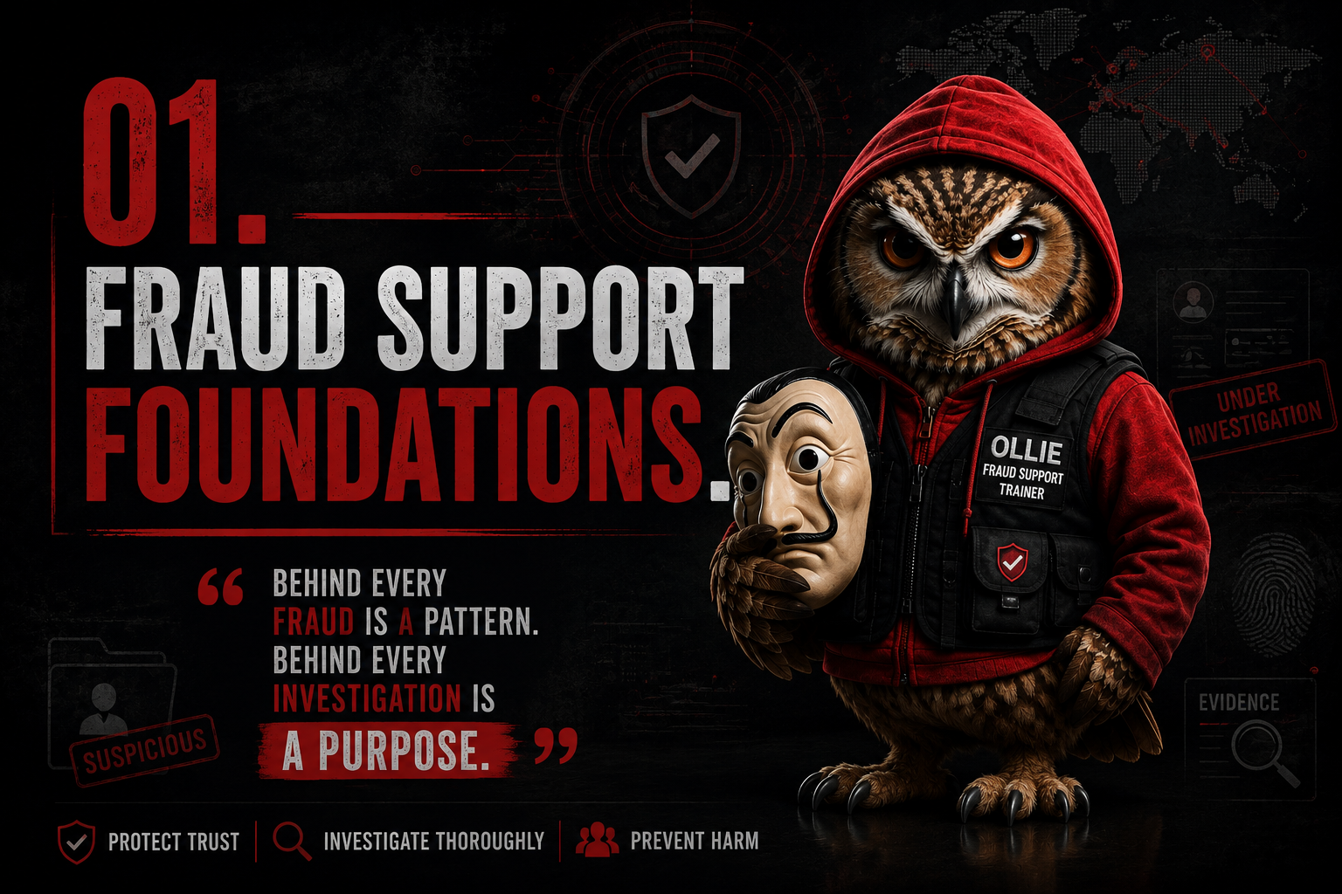

Slide 9

Fraud Support and Its Mission
What is Fraud?
When someone deliberately manipulates content, reviews, or accounts to gain an unfair advantage.
What does the FS team do?
Investigate suspicious activity
Protect content integrity
Ensure a fair experience
Example: Fake Reviews | Misleading Content | Account Misuse | Manipulated Activity (Investigate • Protect • Keep it Fair)
Our Mission
Our primary goal is to protect the integrity of Tripadvisor's content and safeguard the credibility of reviews. We are not a typical customer support team; our focus is on ensuring all content is genuine and unbiased. We are committed to making sure reviews come from travelers with legitimate, non-biased experiences.
Tripadvisor / Fraud Support / Core Mission

Slide 10

Fraud Support & Investigations
Roles and Responsibilities
The Fraud Support and Investigations (INV) teams are the only teams authorized to discuss content integrity issues with owners or reviewers.
Identify and analyze fraudulent patterns
Investigate allegations of fraud, incentives, and vandalism
Take action to remove reviews that violate our guidelines
Document & Communicate our guidelines to prevent fraudulent behaviour in the future
Tripadvisor / Fraud Support / Roles and Responsibilities

Slide 11


Who Contacts Fraud Support
We interact with a wide range of individuals and groups
The Fraud Support and Investigations (INV) teams are the only teams authorized to discuss content integrity issues with owners or reviewers.
Property Owners
Users/Reviewers
Other TA teams
Attorneys/Police
Why?
Why?
Why?
Why?
Review disputes, blackmail reports, etc.
Status of their review, report suspicious activity, etc.
Forwarding user and owner concerns and direct escalations
They contact on behalf of an owner or a user to file a complaint.
This complaint may be about another user or Tripadvisor itself.
Examples
Examples
Examples
Examples
Tripadvisor / Fraud Support / Contact Types

Slide 12
OWNERS · VERBATIM
Why Owners Contact Us
EXAMPLE 1: BLACKMAIL REPORT
EXAMPLE 2: ABUSIVE COMMUNICATION
"Greetings, team. We reach you out for you to assist us since there is a blackmail ongoing. One of the guests had a bad behavior and threatened to submit a bad review unless compensated. The guest won't be admitted at the resort anymore due to his behavior and disrespectful manners."
“The guest used profane, abusive language directed at staff and the company after their review comments were removed, including insults toward Tripadvisor and its moderators."
@FraudOps · Investigator
@FraudOps · Investigator
Note: The excerpts are lightly summarized here; see the full case log for the original text.
Tripadvisor / Fraud Support / Owner Examples

Slide 13
REVIEWERS · VERBATIM
Why Reviewers Contact Us
EXAMPLE 1: REVIEW STATUS
EXAMPLE 2: REPORT SUSPICIOUS ACTIVITY
"Yesterday, I saw a counter sign offering free dessert for a live 5-star Tripadvisor review. Staff were actively pushing diners to review before billing. This violates your anti-incentivization policy and explains their high volume of generic 5-star ratings. Photo evidence attached."
“My review isn't showing up on the hotel page yet; is it still being checked?”
@FraudOps · Investigator
@FraudOps · Investigator
Note: The excerpts are lightly summarized here; see the full case log for the original text.
Tripadvisor / Fraud Support / Reviewer Examples

Slide 14
OTHER TA TEAMS · VERBATIM
Why Other TA Teams Contact Us
EXAMPLE 1: ESCALATION NOTE - OWNER
EXAMPLE 2: ESCALATION NOTE - USER
"Traveler states the business owner threatened physical harm via messaging after a 2-star review was posted. Escalating for immediate profile block and security review."
“Owner uploaded email proof of extortion from the user Traveler_Mike. A 1-star review was just posted. Requesting immediate removal and account block."
@FraudOps · Investigator
@FraudOps · Investigator
Note: The excerpts are lightly summarized here; see the full case log for the original text.
Tripadvisor / Fraud Support / TA Examples

Slide 15
POLICE/ATTORNEY · VERBATIM
Why Police or Attorney Contact Us
EXAMPLE 1: POLICE EXTORTION REPORT
EXAMPLE 2: ATTORNEY SABOTAGE FILE
"Suspect threatened to damage victim's livelihood via text unless given a $1,200 refund. Victim refused; 1-star reviews appeared immediately. Requesting IP logs for prosecution."
"Representing Client #456. Listing targeted by 42 templated 1-star reviews redirecting traffic to a rival. This constitutes trade libel and tortious business interference."
@FraudOps · Investigator
@FraudOps · Investigator
Note: The excerpts are lightly summarized here; see the full case log for the original text.
Tripadvisor / Fraud Support / Police/Attorney Examples

